Slide 1

MSc in Social Science Research Methods
Developing Core research skills
Semester 2 Week 2
Ethics, Access, Confidentiality, Completing the Ethics Form
Dirk Lindebaum

Slide 2
Aims of this session
Explore how Schools’ ethics approval processes are designed to protect people from harm
Examine principles of ethically justifiable research involving people
Outline processes to be followed in seeking ethical approval for proposed research
Note how ethical principles affect seeking access to research participants and protecting confidentiality

Slide 3
1. Guarding against risks of causing harm to people

Slide 4
School ethics approval forms
Forms differ between Schools in detail, but all comply with the University Guidelines and Governance Framework
e.g. Business School three-stage approach:
Form for research using secondary data only (pre-existing data sources)
Standard Ethical Approval form, summary detail, to check if a full application is required
Full Ethics Review form where there are significant risks, requires more detail

Slide 5
School ethics approval processes and forms
Why bother with all this ethics approval business – it’s just a tiresome form-filling exercise!
Share in your group:
What are the different components of your School’s ethics approval process that covers masters dissertations?
Where is the relevant information located?
If there are different ethics approval forms, why is this?
Do you agree? Why or why not?

Slide 6
Which sources of risk are covered?
Do your School’s processes cover other sources of risk?
Any conflicts of interest (e.g. personal relationship with people involved)
Gaining access to people, data, writing
Studying children or vulnerable groups
Informing research participants (or not) about what you’re seeking to find out
Writing up what you find out
Keeping your data securely
Protecting yourself from risk of harm
What potential risks of harm to people are connected with each source?

Slide 7
School ethics approval processes and forms
Are any of these procedures unnecessary – if so, why?
In your group:
Identify the main procedures that researchers are expected to follow when generating data from people
Discuss whether you all agree that you should follow these procedures – why or why not?

Slide 8
Your dissertation and sources of risk
Share in your group:
What are you each proposing to do for your dissertation research?
What, if any, sources of risk do you need to guard against?

Slide 9
2. Principles of ethically justifiable research

Slide 10


Ethical research matters – why?
What ‘ethical research’ means
Social science research – systematic enquiry to gain knowledge about the social world, so the results may be made public
Ethics – rules for conduct that distinguish what is acceptable behaviour from what is not
Ethical research – systematic enquiry within accepted ethical rules of behaviour
Unethical research – systematic enquiry that breaks the accepted ethical rules…

Slide 11
Reminder: induction into a western academic tradition
Originality and independence of individual thinking are highly valued
Individuals own their original ideas (‘intellectual property’)
Everyone is entitled to others’ respect as people, but their ideas may be questioned, criticized or rejected if there are strong enough reasons

Slide 12
UK laws relevant to research
Students are encouraged to develop a strong sense of ethical responsibility as a researcher…
As well as following a western academic tradition…
Everyone in the UK is subject to laws on people’s privacy, generating and using data, and protecting vulnerable groups
So everyone who studies here is accepted on condition that they comply with the ethical rules we accept, and with UK laws
Compliance is monitored for all research conducted by students and academics here
… which includes respecting research participants

Slide 13
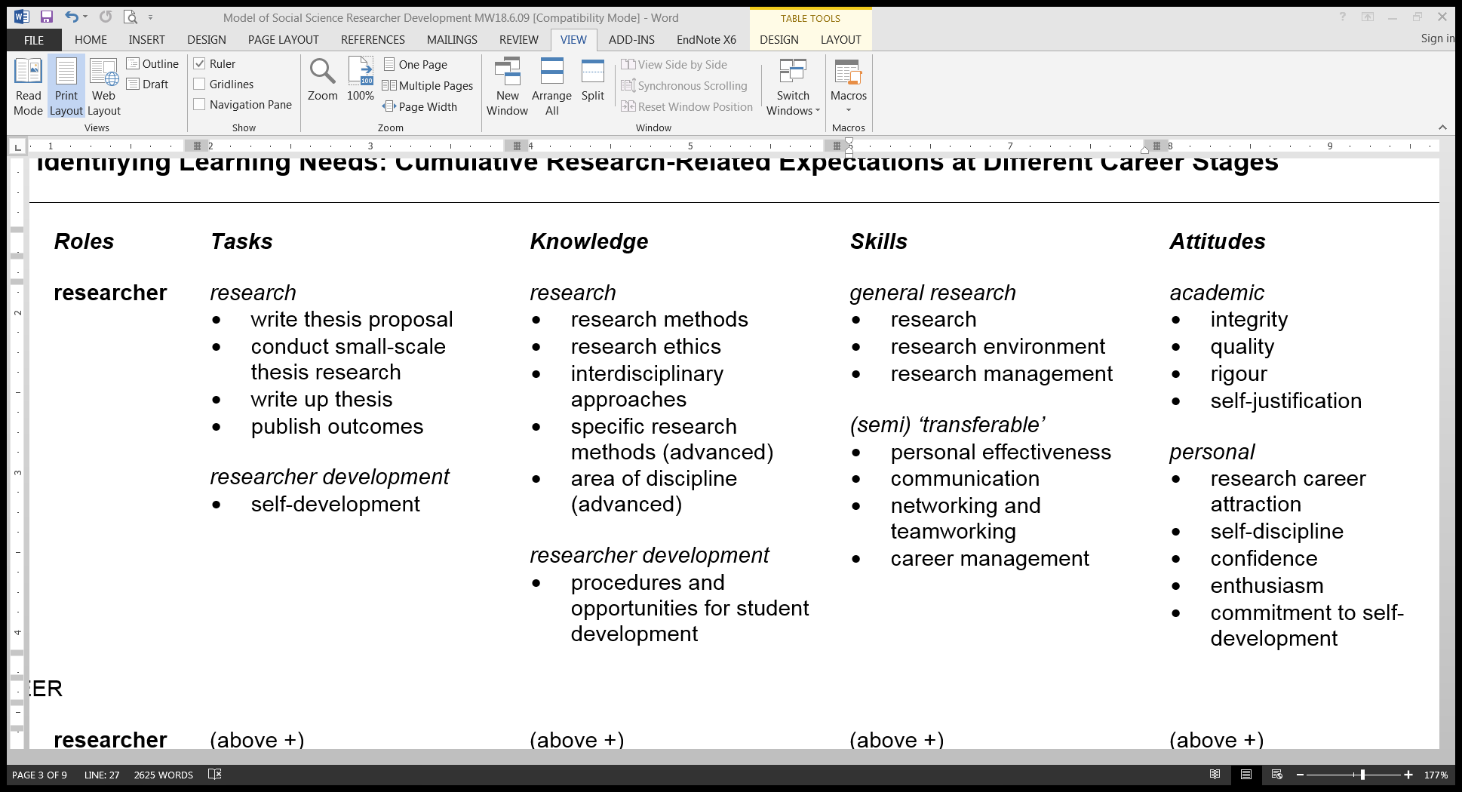
Reminder: common expectations
Academic attitudes entail ethical responsibility

Slide 14
Research ethics evolution
Rules of ethical acceptability within a western tradition repeatedly change with experience
Past evolution – e.g. Milgram experiment
Social psychologist, USA, 1960s
Measured participants’ willingness to obey an authority figure who instructed them to do things conflicting with their conscience
Recruited volunteers through an advert for a ‘study of memory’, small payment for participating
https://www.youtube.com/watch?v=yr5cjyokVUs

Slide 15
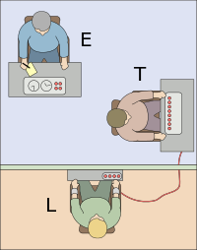
Research ethics evolution
Three individuals, two rooms:
experimenter (E)
teacher (T) – a volunteer
learner (L) – confederate in next room, T believed was volunteer, L said had a ‘heart condition’
E told T to teach L pairs of words and test L’s memory of them
E ordered T to give electric shock to L if gave wrong answer to T’s testing, increased by 15V for each error
After a few shocks, L banged on wall, complaining about heart condition, after more shocks, no response

Slide 16
Research ethics evolution
Most Ts indicated they wanted to stop the experiment
E said T wouldn’t be held responsible, gave T ‘verbal prod’, e.g. ‘The experiment requires that you continue’, ‘Although the shocks may be painful, there is no permanent tissue damage, so please go on’
If T wished to stop after 4 prods, E stopped the experiment
Otherwise continued till T given maximum 450V shock three times

Slide 17
Research ethics evolution
Post-experiment interview and dehoax where:
‘procedures were undertaken to assure that the subject would leave the laboratory in a state of well being. A friendly reconciliation was arranged between the subject and the victim, and an effort was made
to reduce any tensions that arose as a result of the experiment’. (Milgram 1963) *
* Milgram, S (1963) Behavioral study of obedience, Journal of Abnormal and Social Psychology 67 (4): 371-8

Slide 18
Research ethics evolution
In western universities this kind of research is now viewed as unethical – it is banned….ethics creep...
Result – about 65% of participants administered maximum ‘shock’ despite L’s (simulated) screams of pain
All questioned the experiment
All displayed tension and stress, e.g. sweating, trembling, biting lips, nervous laughs
Milgram’s interpretation – extreme willingness to obey authority even where it conflicts with moral imperative against hurting others
Variants of experiment repeated, with women and men, in different countries, similar results

Slide 19
Was Milgram’s research unethical?
In your group, imagine you had all taken part in one of Milgram’s experiments as a ‘teacher’, and had afterwards been through the interview and dehoax:
Share what you would feel about the ethics of your recruitment, involvement in the experiment, and dehoax experience
Why do you think Milgram’s research is now widely considered to be unethical?

Slide 20
Research ethics evolution
Current evolution – ethical implications of research on uses of new electronic technologies (and research methods using them) e.g. generating data on
purchasing habits
travel (e.g. GPS tracking)
website browsing
written or photographic output in social media (e.g. Facebook, blogs, Twitter)

Slide 21
Research ethics evolution
These ethical issues are still being debated…
Sources of risk with internet sources include:
Domain easily accessed (so public) but users perceive it as private (e.g. chatroom)
Easy to generate data without internet users’ consent (e.g. save content from chatroom)
Researcher and participants may interact online but never meet or speak to each other, choose ‘virtual’ identities that are unlike their ‘real’ self (e.g. children pretend to be adults)
So researchers could invade privacy, fail to gain consent, get data from unsuitable sources
Are you aware of emerging technology that could raise new ethical issues in future?

Slide 22
A research methods innovation – Collaborative Online Media Observatory (COSMOS)
Some of you are involved with COSMOS
‘Big data’ programme, includes software for accessing and analysing social media
One focus on the ethical impact of big social data – using new technology to study uses of social media brings new sources of risk
Research includes accessing and analysing lots of social media posts (e.g. Tweets)

Slide 23
COSMOS ethics statement
Does COSMOS promote ethical research?
Individually, read through the COSMOS ethics statement (handout p1), to see what sources of risk it covers
In your group, consider:
How adequately does the COSMOS statement guard against the risks of its research causing harm to social media users – why or why not?

Slide 24
Ethical research – what’s in it for you?
These reasons may be instrumental (a means to an end), e.g. to advance your career
Help achieve your research aims (e.g. gain access, valid knowledge, avoid errors or complaints)
Foster collaboration (e.g. trust for disclosure)
Make your research accountable (e.g. to public, funders)
Build public support for your research (e.g. trust researchers’ integrity, do good not harm)
Promote wider moral values (e.g. human rights, legal compliance)
They may be intrinsic (ends in themselves), e.g. to live a just life

Slide 25
Codes of ethical research practice
Most cover principles of self-conduct, including
Honesty (e.g. communicating with your supervisor, reporting data, writing the account of your study, respecting others’ intellectual property)
Rigour (e.g. in planning, record-keeping, ensuring data security, proofreading written work)
Openness (e.g. sharing your ideas and results, listening to constructive criticism and new ideas)
Collegiality (e.g. respecting and collaborating with other students and academics, helping others learn)
Non-discrimination (e.g. avoiding stereotypical assumptions about other students, academics)

Slide 26
Codes of ethical research practice
And of conducting research involving people, including
Minimizing harms and risks (e.g. avoiding unnecessary stress for research participants, protecting information given in confidence, protecting researchers from harm)
Maximizing benefits (e.g. giving generalized feedback to research participants, informing policy)
Respecting human dignity, privacy, and autonomy (e.g. being polite, not embarrassing your research participants, accepting no for an answer)
Taking special precautions with those who are vulnerable to exploitation (e.g. ensure informed consent of participant, or appropriate proxy)

Slide 27
Exploring a Code of Research Ethics
Which principles of self-conduct and research conduct did Milgram’s research fail to comply with?
Individually, read the extract from the UK Government’s Universal Ethical Code for Scientists (handout p2)
In your group, identify what explicit and implicit principles the Code promotes for
Self-conduct as a researcher
Conducting research involving people

Slide 28
Exploring a Code of Research Ethics
APA Ethics guidelines on informed consent:
that participants are informed about (1) the purpose of the research, expected duration, and procedures; (2) their right to decline to participate and to withdraw from the research once participation has begun; (3) the foreseeable consequences of declining or withdrawing; (4) reasonably foreseeable factors that may be expected to influence their willingness to participate such as potential risks, discomfort, or adverse effects . (APA, 2010, section 8.02, italics added)

Slide 29
3. Research ethics approval processes

Slide 30
Ethical research assurance
Your School’s Research Ethics Committee (SREC) reviews and approves non-clinical research proposals from students and academics based in the School
Cardiff University holds itself accountable for ethical standards of all our student and academic research
Supports UK government’s Universal Ethical Code for Scientists (handout p2)
Code reflected in our Ethical Guidelines and Research Governance Framework (regulations, standards)
All Schools have Research Ethics Committee
Responsible for ethics review of proposals from researchers based in the School

Slide 31
When is ethical approval required?
In some Schools, you MUST secure ethical approval for your proposed dissertation research (whether it raises ethical issues or not)
And also for any future research involving human - participants (e.g. observation, questionnaire) - material (e.g. tissue – unlikely for your work) - data that isn’t publicly available (e.g. personal financial records or communications on Facebook)
For future research where the only data source is publicly and lawfully available information on human participants (e.g. UK census data), you must complete a form indicating this

Slide 32
Process for your dissertation
See the SSRM dissertation handbook, p9-11 (available on Learning Central)
Locate your SREC’s Ethics Approval forms and accompanying information required (you should know where to find these!)
Complete the appropriate form and accompanying information (you may have to complete a form even if you are using secondary data only)…

Slide 33
Process for your dissertation
Ask your supervisor to check, sign, return the completed form to you…
send forms and accompanying information (usually two copies) to your SREC, and another copy to SSRM Office by 5th April 2017
In some Schools, you MUST also include a copy of your approval letter or stamped form as an appendix in your dissertation (to demonstrate you received approval)

Slide 34
4. Access and confidentiality – some advice

Slide 35
Gaining access
Conducting research may require access to data sources which requires ‘gatekeepers’ to give their permission, including:
- Sites (e.g. public organizations, companies)
- Participants (e.g. email list, interviewees)
- Databases (e.g. company financial records)
- Personal data (e.g. shared on Facebook)
Find out what the rules and procedures are, and who are gatekeepers for access decisions
Plan how to approach gatekeepers ethically

Slide 36
Gaining access
You can improve your chances of gaining access to people by showing that you will minimize commonly perceived risks, e.g.
Seek informed consent
Protect confidentiality
In your group, share in turn:
What (if any) access do you need for your proposed dissertation research?
Who are the gatekeepers?
What risks might they worry about if they were to give you permission?
What could you do to help pre-empt or minimize such worries?

Slide 37
Informed consent
Where possible, you must gain people’s written consent to be research participants
Their consent must normally be - freely given (they may refuse, or withdraw at any time, without giving a reason) - fully informed (about the purpose, methods, intended uses of your research, any risks involved for them)
Be transparent about your research purposes if possible…
…covert or deceptive research requires strong ethical justification!

Slide 38
Confidentiality and anonymity
State exactly what you mean by confidentiality and anonymity (and any limits), so participants can give fully informed consent
Respecting participants’ right to privacy:
Confidentiality – restricting access to raw data, ensuring secure storage, destruction by set date - Limits e.g. duty to report harmful behaviour, elite participants may be identifiable
Anonymity – concealing participants’ identity (e.g. fictionalalize people’s names, places, events in transcripts and publications) - Research participants are entitled to reject means of data generation (e.g. recorder)

Slide 39
Confidentiality and anonymity
Implications of the UK Data Protection Act:
Consent for data stored anonymously entails informing participants just about this (as their data cannot be traced to them)
Consent for data stored confidentially entails informing participants: - who will have access to it - how long it will be retained - that they have the right to see or remove it, and have it explained to them at any time (as their data can still be traced to them)
Consider storing data anonymously unless you need to return to participants for further study

Slide 40
Sustaining access and consent
Keep a record of the access and consent process, e.g.
your account of negotiations
copies of all documents
Access and consent are processes, not a one-off negotiation event! At any time:
Gatekeepers can withdraw their permission
Research participants can withdraw their co-operation and encourage others to do so
To help sustain access and consent, act:
Ethically (e.g. be respectful, protect confidentiality, provide generalized feedback)
Prudently (e.g. dress to ‘fit in’ with or respect others’ expectations, avoid invading privacy)
You may need to refer to them
when writing your methods chapter
if access or consent problems arise

Slide 41
Further information (handout p2)
Links to websites:
Cardiff university research ethics requirements and guidelines
Introduction to research ethics, sections on researching vulnerable people, using secondary data, web-based research
Guidebook – resource for social scientists
ESRC research ethics framework
Check ethics guidelines of relevnat societies (APA, ASA etc)
Any questions on access, consent, confidentiality?

